Slide 1
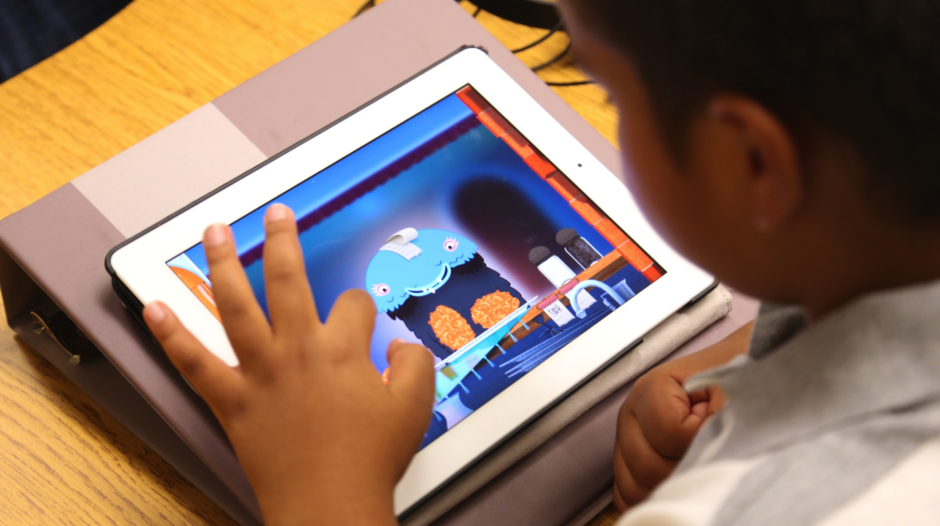
Smart Schools Investment Plan
Rochester City School District
April 2016

Slide 2
What is the Smart Schools Bond Act?
Passed in the 2014-15 Enacted Budget and approved by the voters in a statewide referendum held during the New York State 2014 General Election on Tuesday, November 4, 2014.
Authorized the issuance of $2 billion of general obligation bonds to finance improved educational technology and infrastructure to improve learning and opportunity for students throughout the State.
The Rochester City School District has been allocated $47,234,577 for this purpose. This will be paid to the District by New York State as reimbursement for technology expenses under the plan.

Slide 3
Our Vision
To create an educational culture that empowers students
to succeed in the learning process by utilizing technology
as a support for learners to become prepared
for college, career and life.

Slide 4
Requirements to Attain Funding
Submit Three Year District Technology Plan to the State
SED Facilities Department Preview of RCSD Plan
Board approval of Preliminary Smart Schools Investment Plan
Preliminary Smart Schools Investment Plan - Public Hearing
Post Preliminary SSIP for 30 days for community comments
Board approval of a Final Smart Schools Investment Plan
Post the Final SSIP on the district website
SSIP submission to NYSED for approval

Slide 5
Smart Schools Timeline
April 2015 Smart Schools Instructions sent to Districts from State Ed (SED)
Oct 2015 RCSD Technology Plan Approved by SED
Jan-March 2016 Meet with Stakeholders
- Internal: Digital Curriculum Focus Group, Superintendent,
SPED, Library, Edison (Complete)
- SUNY (In Process)
- Non-Public Schools (Complete)
- Students (Complete)
April 28 2016 Board approves Preliminary Plan
April 28 2016 Posting of Plan for Public Review
May 31 2106 Public Hearing on Plan
June 16 2016 Board Approves Final Plan
July 1 2016 Final Plan submitted to SED
July-Sept 2016 SED approval of spending plan
Oct 2016 Begin implementation of plan – Year 1

Slide 6
Smart School Plan Presentations
Board of Education
Board Finance Committee:
4/21/2016
6/9/2016
Board Business Meeting:
4/28/2016
6/16/2016
Superintendent: 2/10/2016
Leadership Team: 3/9/2016
Principals: 5/19/2016
Assistant Principals: 5/23/2016
Teachers
5/23/2016
6/6/2016
Non-Public Schools: 3/3/2016
Students: 2/24/2016
Parent Advisory Committee: 3/10/2016
Unions
ASAR: 4/27/2016
RTA: 4/27/2016
RAP: 5/13/2016
Bente: 6/9/2016
Public Hearing: 5/31/2016

Slide 7
Plan Overview
SSBA Allocation: $47,234,577
School Connectivity $6M
Connectivity Projects for Communities $6M (Community Broadband)
Classroom Technology 23.9M
Non-Public School $339,750 ($250 per student)
Replace Transportable Classrooms $8.5M
High-Tech Security $2.5M

Slide 8
School Connectivity
Goal is to Expanded Wi-Fi Coverage District-wide at 22 Buildings
Laptops, and Chromebooks can then be used online anywhere in the district
As devices increase we need to increase the density as well
The wireless network can accommodate computer-based testing of large numbers of students simultaneously
Additional Network Upgrade Needed in 42 Buildings
Budget Amount: $6,000,000
Budget Amount: $6,000,000

Slide 9
Connectivity Projects for Communities
Support Student 1-1 program with home internet access
Provides Broadband Capability to Buildings Supporting our Students
Libraries
Community Centers
Pursing the New York State Broadband Grant to Expand Coverage
Budget Amount: $6,000,000
Budget Amount: $6,000,000

Slide 10
Classroom Technology
Pre-K 6 iPads
K-1 6 iPads 4 Desktop Chromebooks
Grade 2 6 iPads 4 Chromebooks
Grades 3-6 1:1 Carts in every classroom 25 Units per cart
Grades 7-8 1:1 Carts in every classroom 28 Units per cart
Grades 9-12 1:1 For Every Student Year 1, classroom carts Year 2, Take-home
Considerations: 12:1:1, 6:1:1 classrooms; Specialized Device configuration for the Virtual Program, Rochester International Academy (RIA), Edison, etc.
Budget Amount: $12,500,000

Slide 11
Classroom Technology
Interactive Boards w/Projectors – Elementary Classrooms
HDTV Secondary Classrooms
Projectors – Secondary Classrooms
Touchscreen Desktops – Secondary Classrooms
Refresh Student Equipment – 4 Years
iPads
Chromebooks
Carts
School Library Configurations:
Smartboards – Elementary School Libraries
High Def Monitors – Secondary School Libraries
Document Cameras – all libraries
3D Printers to loan to schools
Library Computer Lab Updates, as needed
Budget Amount: $11,400,000

Slide 12
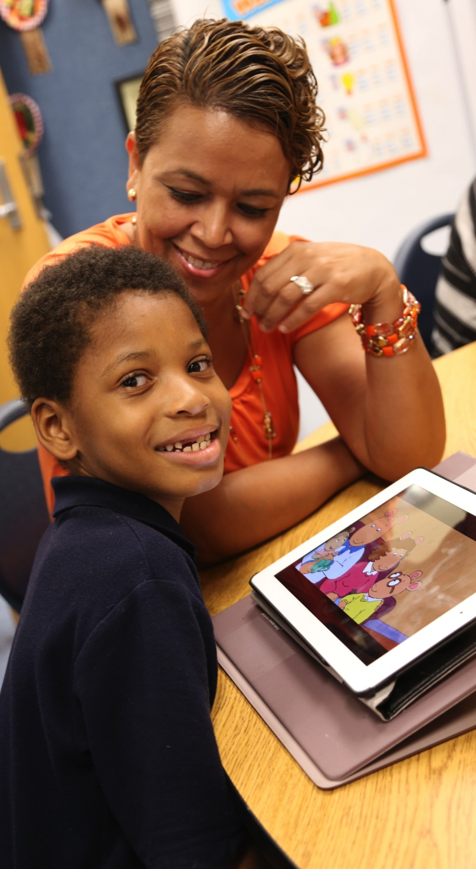
Professional Development
Differentiated Professional Development
Online and Face-to-Face Professional Development for Teachers and Administrators
Engaging Coaches, Mentors and School Technology Leaders
In-Classroom Coaching for teachers
Collegial Circles to Share Best Practices – Teachers and Administrators
Technology + Teacher Professional Development focused on pedagogy =
POSITIVE STUDENT OUTCOMES

Slide 13
Professional Development
$250/student allocation for all Rochester City Non-Public Schools
Budget Amount: $500,000

Slide 14
Replace Transportable Classrooms
Eliminate Aging Transportable Classrooms
Augment Funding for Facilities Modernization Program – Phase II FMP
Budget Amount: $8,500,000

Slide 15
High-Tech Security Features
Replace Aging Analog Cameras (approximately 729) with High Resolution Digital Ones
Expand Storage For Video
Expands Coverage (add approximately 200 cameras)
Budget Amount: $2,500,000

Slide 16
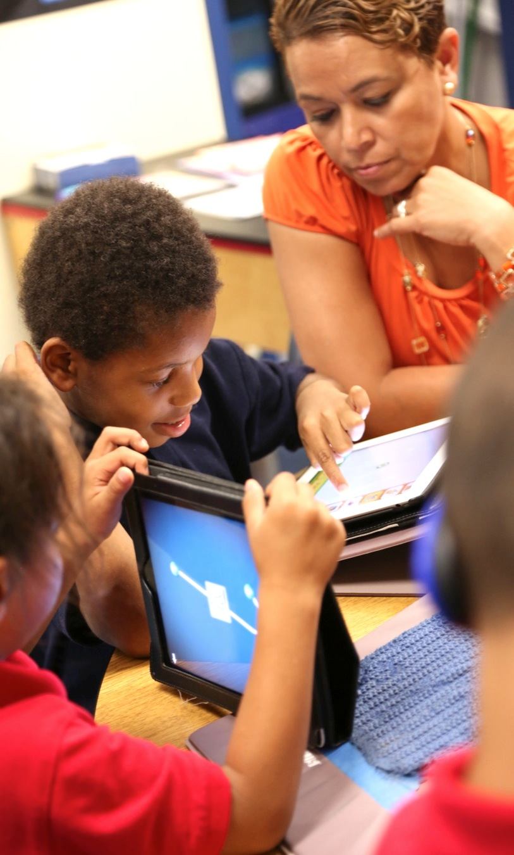
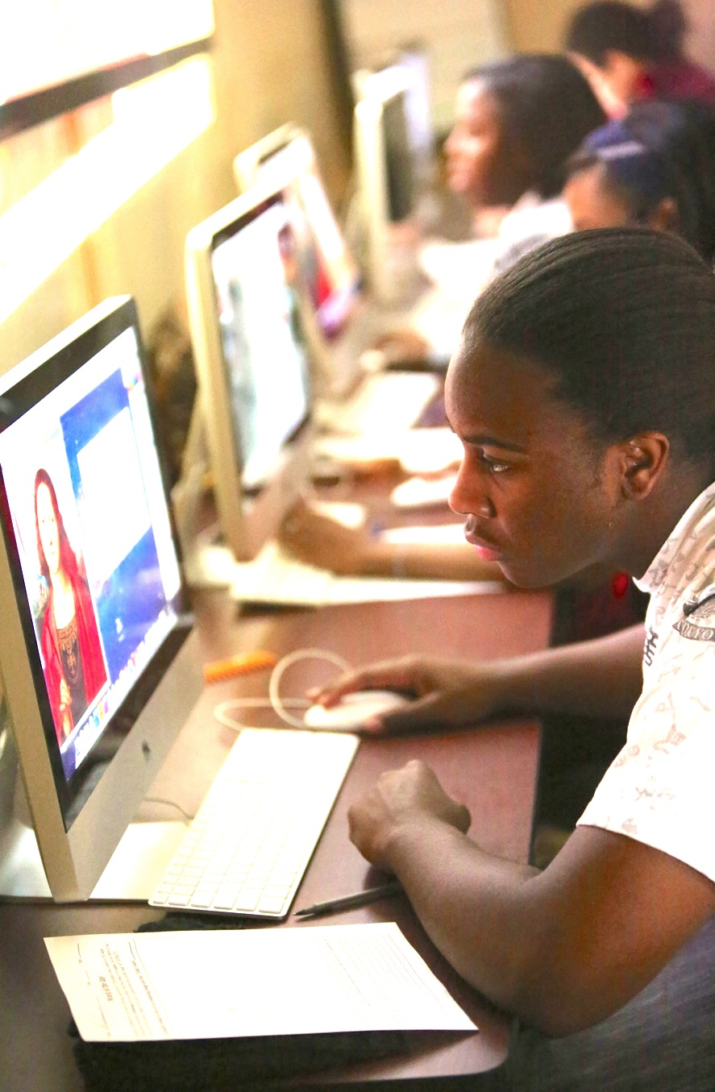
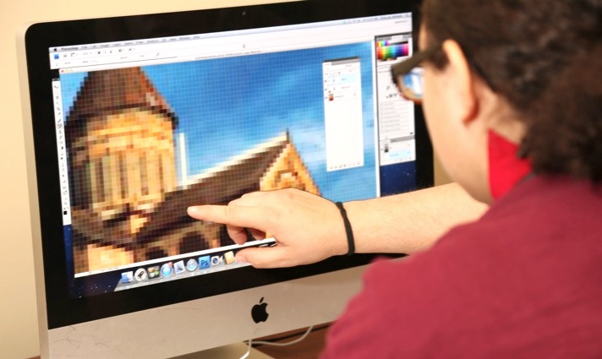
RCSD’s Digital Transformation!

